Slide 1


آموزش مفاهیم داده کاوی به زبان ساده
تحلیل‌گرشو
آموزش مفاهیم داده کاوی به زبان ساده
گروه مثبت دیتا
Mosbatedata
جلسه اول:
مقدمات پایتون
اسفند 1400

Slide 2
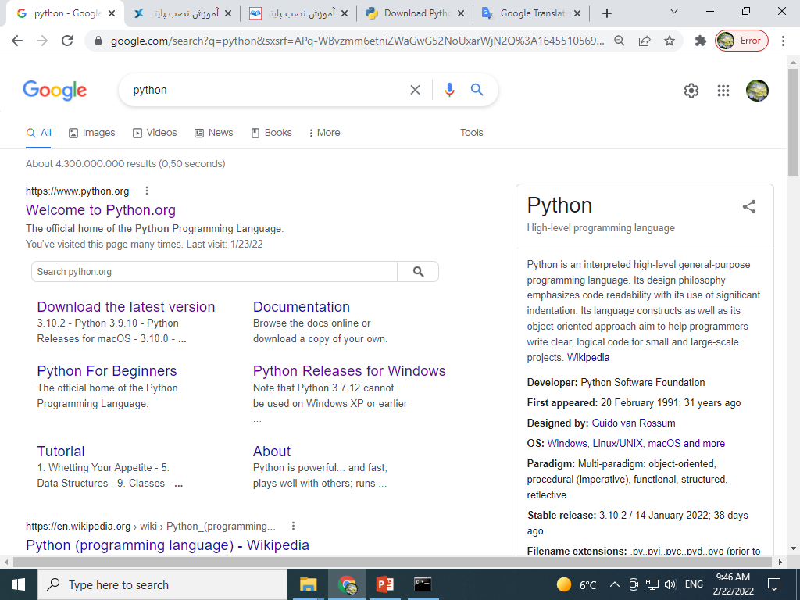
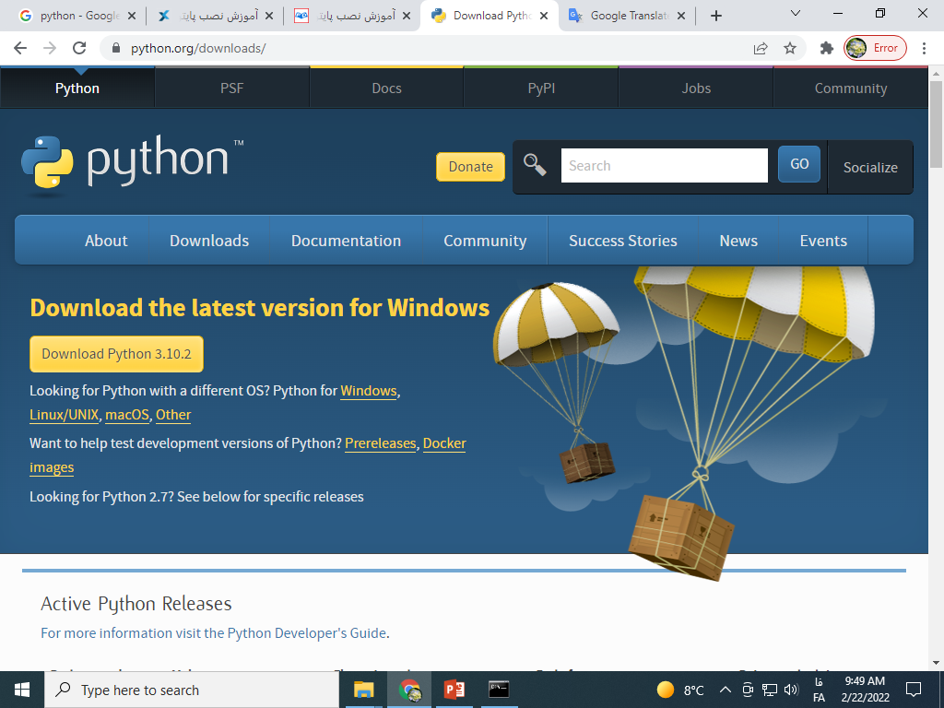
نصب پایتون
۱
۲

Slide 3
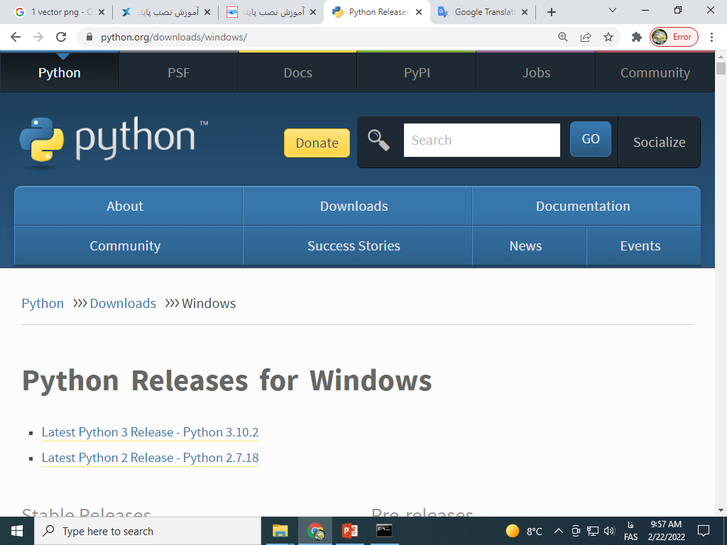
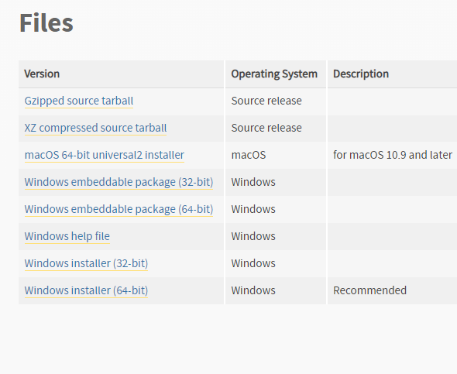
نصب پایتون
3
4

Slide 4
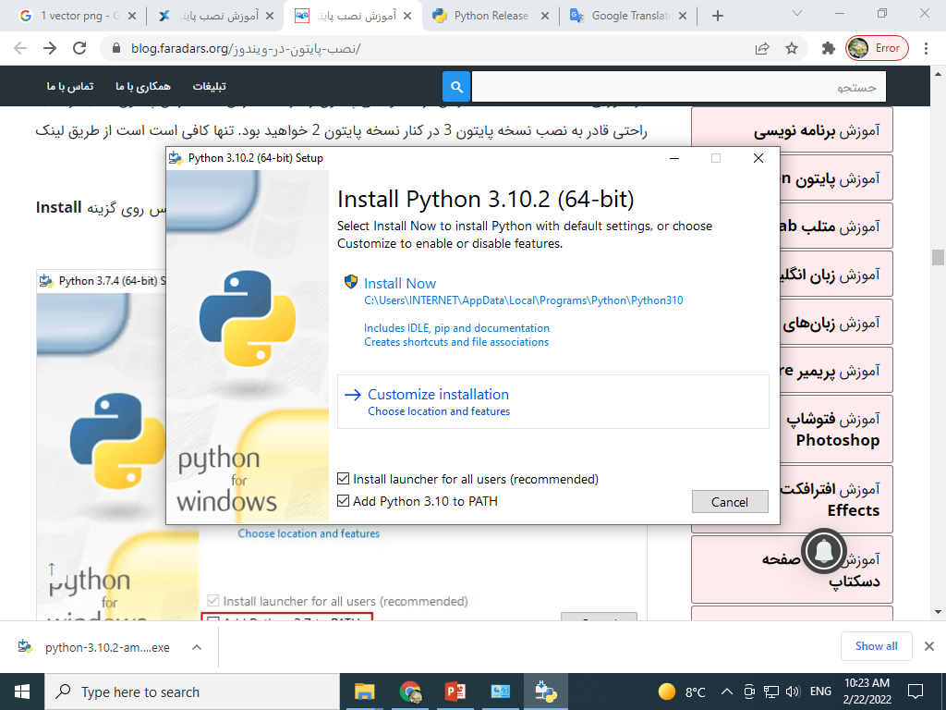
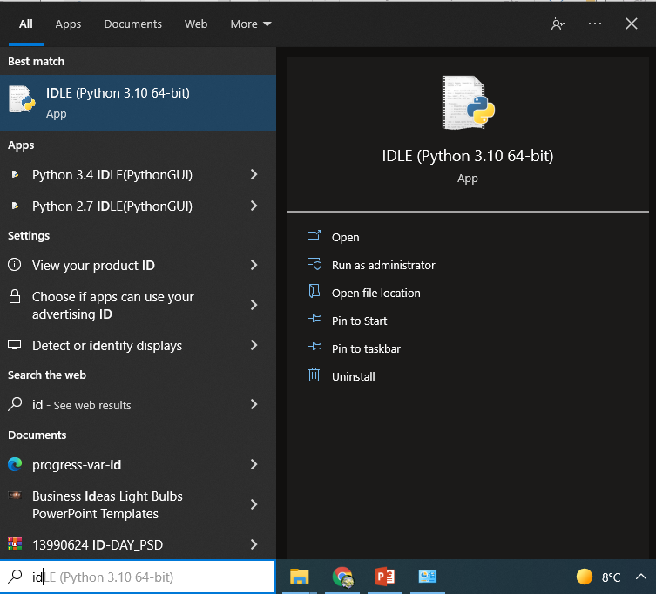
نصب پایتون
5
6

Slide 5
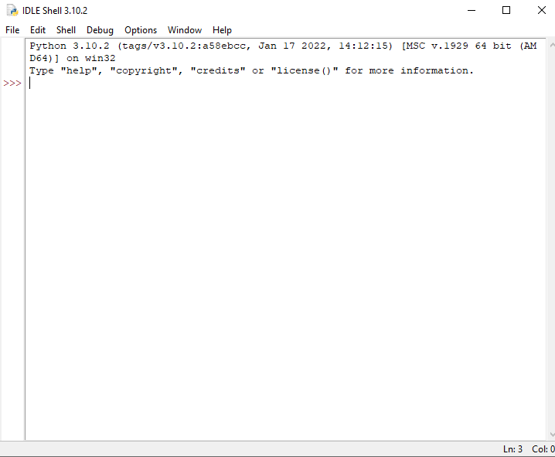





نصب پایتون
Integrated Development Environment (IDE)
محیط توسعه یکپارچه

Slide 6
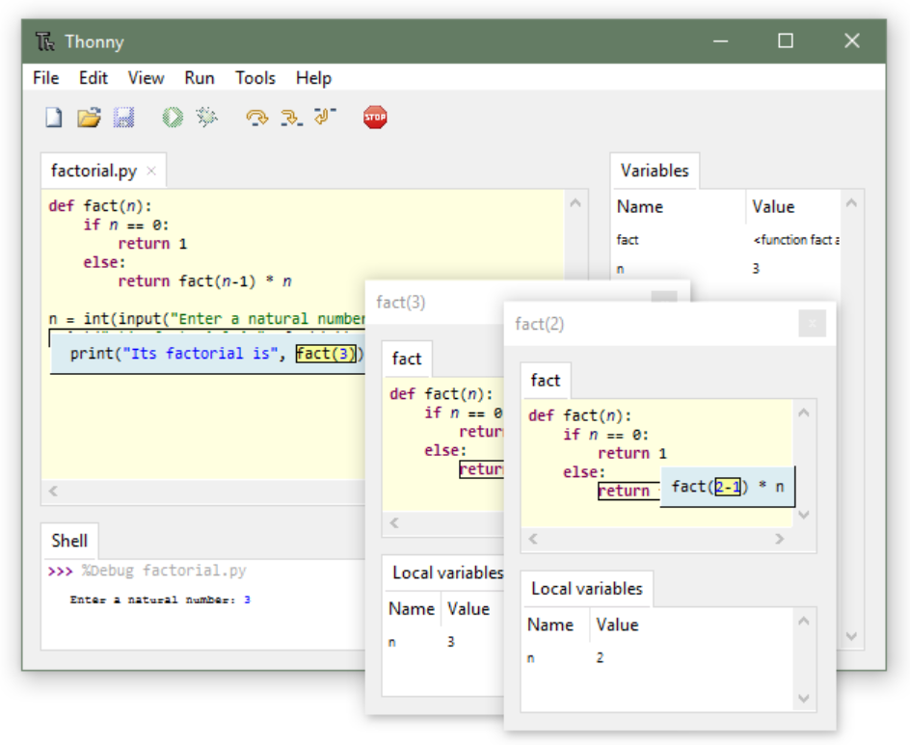
Python IDE for beginners

Slide 7

pip is a package-management system written in Python used to install and manage software packages

Slide 8
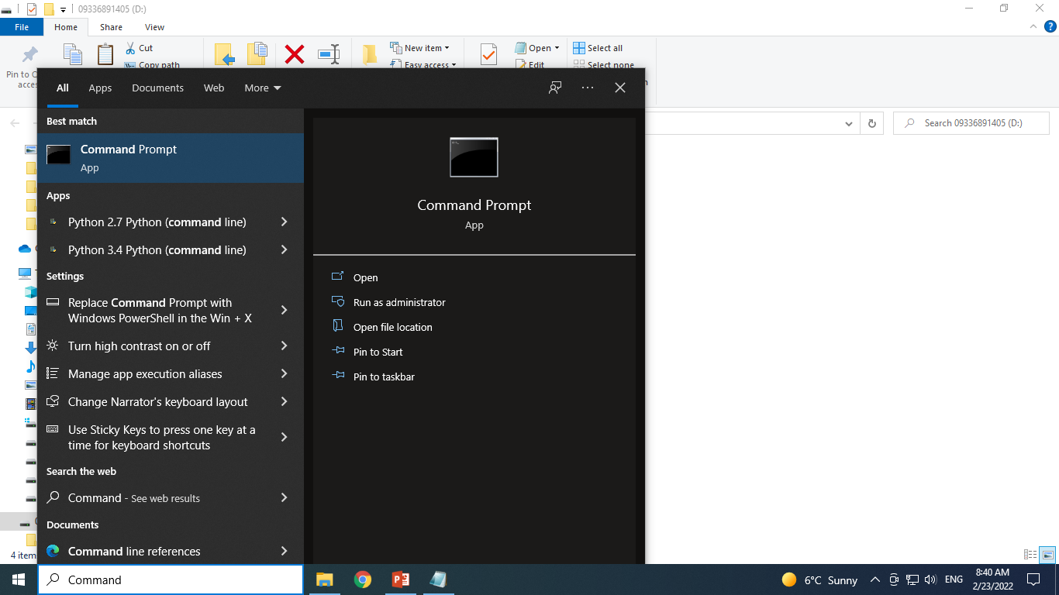
PIP
> python -m pip --version
ورژن پیپ که نصب شده چنده؟ اصلا نصب هست؟؟
> python -m pip install --upgrade --user pip
نصب و بروز رسانی PIP

Slide 9




نام ژوپیتر به سه زبان برنامه‌نویسی که مورد پشتیبانی این پروژه هستند برمیگردد
> python -m pip install --upgrade --user notebook

Slide 10
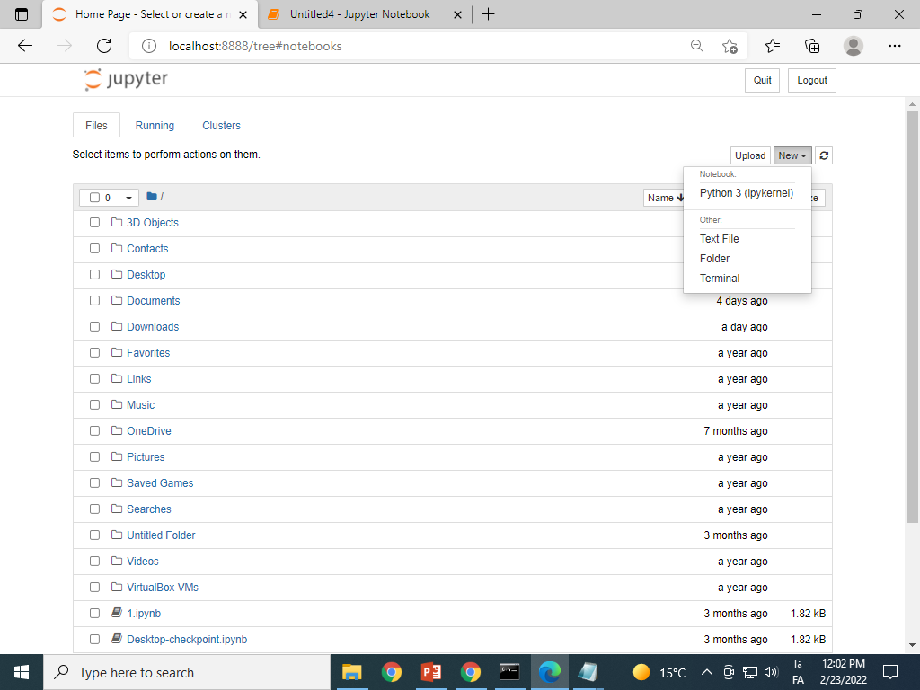
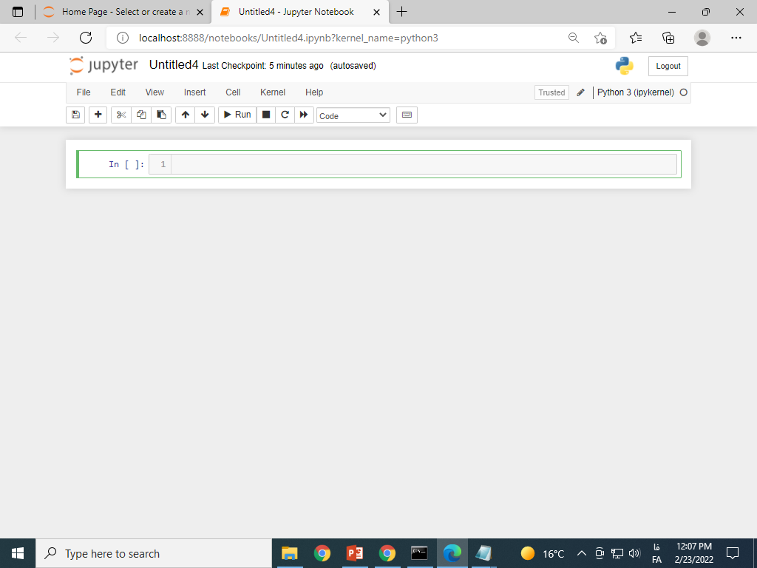
> python -m notebook
فراخوانی ژوپیتر

Slide 11
Coding in Python
Start
Comparison operators
Logical operators
Identity operators
Membership operator
Condition
Loop
Function
Modules
Method
List slice
String
Encoding
String Method
print("Hello, World!")
Run
Hello, World!
input ("Username: ")
Run
Username:
Hosein68
"Hosein68"
list_name = [5, 4.3, "Hosein68"]
ABC_123
type(list_name)
Run
list

Slide 12
Coding in Python
Start
Comparison operators
Logical operators
Identity operators
Membership operator
Condition
Loop
Function
Modules
Method
List slice
String
Encoding
String Method
== != <> > < >= <=
x = 1
Run
x == 1
Run
True
x != 1
Run
False
x >= 1
Run
True

Slide 13
Coding in Python
Start
Comparison operators
Logical operators
Identity operators
Membership operator
Condition
Loop
Function
Modules
Method
List slice
String
Encoding
String Method
and or not
a = 10
b = 10
c = -10
a > 0 and b > 0
True
a > 0 and c > 0
False
a > 0 or c > 0
True
Run
a = 10
b = 10
c = -10
Run
Run

Slide 14
Coding in Python
Start
Comparison operators
Logical operators
Identity operators
Membership operator
Condition
Loop
Function
Modules
Method
List slice
String
Encoding
String Method

Slide 15
Coding in Python
Start
Comparison operators
Logical operators
Identity operators
Membership operator
Condition
Loop
Function
Modules
Method
List slice
String
Encoding
String Method

Slide 16
Coding in Python
Start
Comparison operators
Logical operators
Identity operators
Membership operator
Condition
Loop
Function
Modules
Method
List slice
String
Encoding
String Method

Slide 17
Coding in Python
Start
Comparison operators
Logical operators
Identity operators
Membership operator
Condition
Loop
Function
Modules
Method
List slice
String
Encoding
String Method

Slide 18
Coding in Python
Start
Comparison operators
Logical operators
Identity operators
Membership operator
Condition
Loop
Function
Modules
Method
List slice
String
Encoding
String Method

Slide 19
Coding in Python
Start
Comparison operators
Logical operators
Identity operators
Membership operator
Condition
Loop
Function
Modules
Method
List slice
String
Encoding
String Method

Slide 20
Coding in Python
Start
Comparison operators
Logical operators
Identity operators
Membership operator
Condition
Loop
Function
Modules
Method
List slice
String
Encoding
String Method

Slide 21
Coding in Python
Start
Comparison operators
Logical operators
Identity operators
Membership operator
Condition
Loop
Function
Modules
Method
List slice
String
Encoding
String Method

